Slide 1
Heart Disease Prediction Using Machine Learning
By
MD. NAJMUL ISLAM– CSE1903018092
MD. NUR ISLAM – CSE1903018105
NAZMUL HOSSAIN – CSE1903018114
MD. MAFUJUL HASAN – CSE1903018137

Slide 2

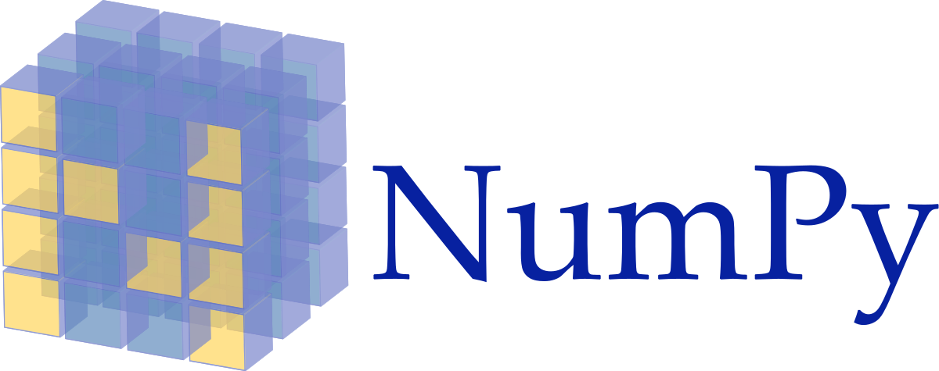
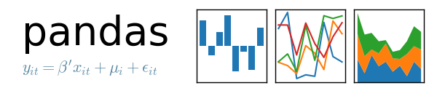


Content
Importing the required libraries.
Importing and Reading the dataset.
Exploratory Data Analysis (EDA)
Data-Preprocessing
Data Visualization
  Correlation Matrix
  Pair plots
  Count plots
Data Modeling
  Separating the data into features and target variable.
  Splitting the data into training and test sets.
  Modeling/ Training the data
  Creating a function to find best model algorithm
  Predicting the data
  Calculating the prediction scores
  Getting the model's accuracy
    Classification Report
    Confusion Matrix

Slide 4
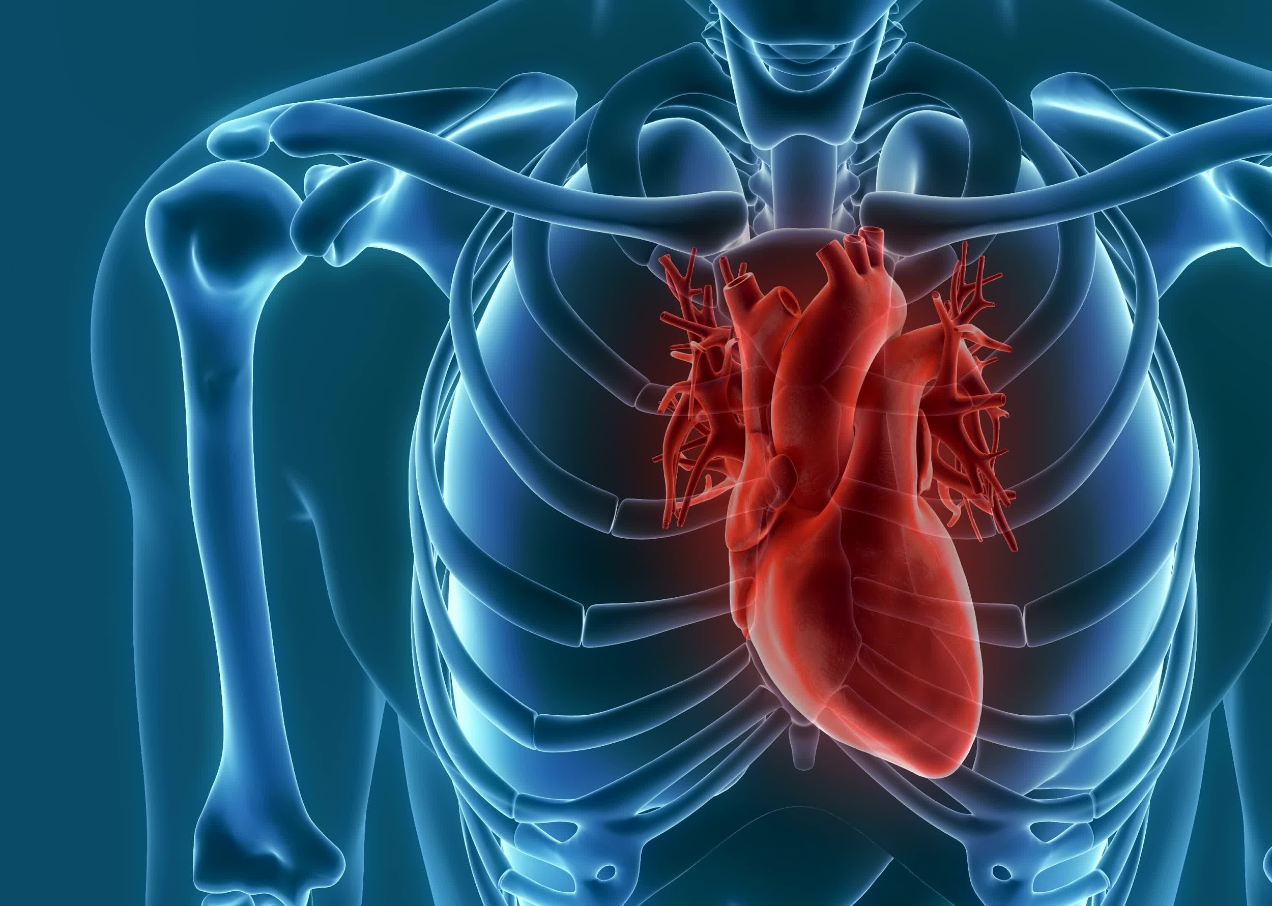
The Working of the Project
4
4
4

Slide 5
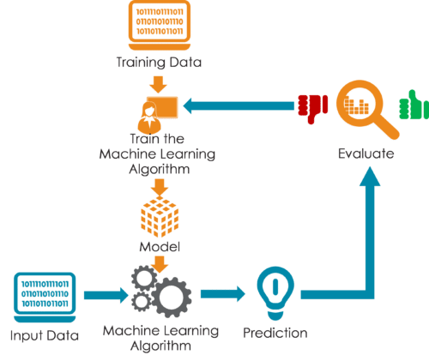
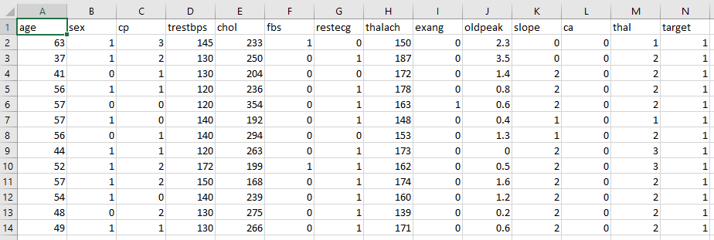
Dataset

Slide 6

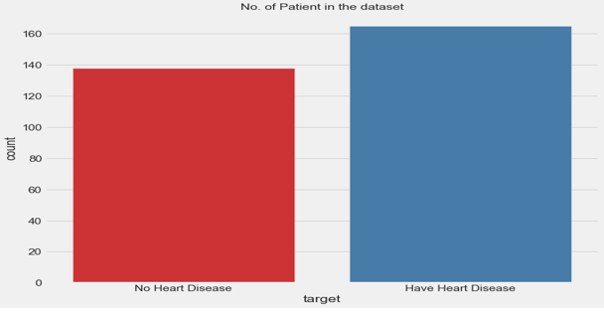
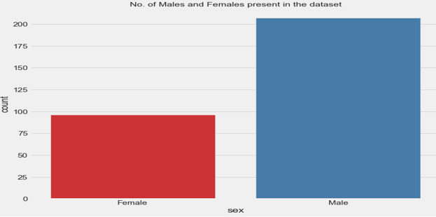
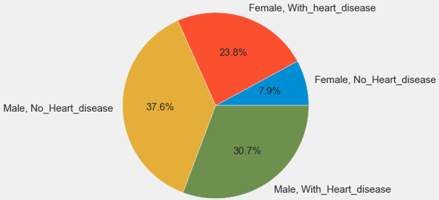
Dataset
Total Number of Male and Female having or have not heart disease in Dataset
Total Number of Patient having or have not heart disease in Dataset
Number of male and female Patient in Dataset
6
Total Number of Male Patients in Dataset = 207
Percentage of Male Patients in Dataset = 68.32%
Total Number of Female Patient in Dataset = 96
Percentage of Female Patients in Dataset = 31.68%
Total Number of Patients having Heart Diseases = 165
Percentage of Patients have Heart Diseases = 54.46%
Total Number of Patient have no Heart Diseases = 138
Percentage of Patients have no Heart Diseases = 45.54%
Total Number of Male having Heart Diseases = 93
Total Number of Male have No Heart Diseases = 114
Total Number of Female have Heart Diseases = 72
Total Number of Female have no Heart Diseases = 24

Slide 7
Total Number of Male and Female having or have not heart disease in Dataset
Total Number of Patient having or have not heart disease in Dataset
Number of male and female Patient in Dataset
Total Number of Male Patients in Dataset = 207
Percentage of Male Patients in Dataset = 68.32%
Total Number of Female Patient in Dataset = 96
Percentage of Female Patients in Dataset = 31.68%
Total Number of Patients having Heart Diseases = 165
Percentage of Patients have Heart Diseases = 54.46%
Total Number of Patient have no Heart Diseases = 138
Percentage of Patients have no Heart Diseases = 45.54%
Total Number of Male having Heart Diseases = 93
Total Number of Male have No Heart Diseases = 114
Total Number of Female have Heart Diseases = 72
Total Number of Female have no Heart Diseases = 24

Slide 8
Total Number of Male and Female having or have not heart disease in Dataset
Number of male and female Patient in Dataset
Total Number of Patient having or have not heart disease in Dataset
Total Number of Patients having Heart Diseases = 165
Percentage of Patients have Heart Diseases = 54.46%
Total Number of Patient have no Heart Diseases = 138
Percentage of Patients have no Heart Diseases = 45.54%
Total Number of Male Patients in Dataset = 207
Percentage of Male Patients in Dataset = 68.32%
Total Number of Female Patient in Dataset = 96
Percentage of Female Patients in Dataset = 31.68%
Total Number of Male having Heart Diseases = 93
Total Number of Male have No Heart Diseases = 114
Total Number of Female have Heart Diseases = 72
Total Number of Female have no Heart Diseases = 24

Slide 9
3 Step Process
Total Number of Patient having or have not heart disease in Dataset
Number of male and female Patient in Dataset
Total Number of Male and Female having or have not heart disease in Dataset
Train the dataset
Split the dataset
Finding best Algorithm Model
Total Number of Male having Heart Diseases = 93
Total Number of Male have No Heart Diseases = 114
Total Number of Female have Heart Diseases = 72
Total Number of Female have no Heart Diseases = 24
Total Number of Male Patients in Dataset = 207
Percentage of Male Patients in Dataset = 68.32%
Total Number of Female Patient in Dataset = 96
Percentage of Female Patients in Dataset = 31.68%
Total Number of Patients having Heart Diseases = 165
Percentage of Patients have Heart Diseases = 54.46%
Total Number of Patient have no Heart Diseases = 138
Percentage of Patients have no Heart Diseases = 45.54%
9

Slide 10
Total Number of Male and Female having or have not heart disease in Dataset
Total Number of Patient having or have not heart disease in Dataset
Number of male and female Patient in Dataset
3 Step Process
Finding best Algorithm Model
Train the dataset
Split the dataset
Total Number of Male Patients in Dataset = 207
Percentage of Male Patients in Dataset = 68.32%
Total Number of Female Patient in Dataset = 96
Percentage of Female Patients in Dataset = 31.68%
Total Number of Male having Heart Diseases = 93
Total Number of Male have No Heart Diseases = 114
Total Number of Female have Heart Diseases = 72
Total Number of Female have no Heart Diseases = 24
Total Number of Patients having Heart Diseases = 165
Percentage of Patients have Heart Diseases = 54.46%
Total Number of Patient have no Heart Diseases = 138
Percentage of Patients have no Heart Diseases = 45.54%
10

Slide 11
3 Step Process
Finding best Algorithm Model
Train the dataset
Split the dataset
11

Slide 12
3 Step Process
Finding best Algorithm Model
Split the dataset
Train the dataset
12

Slide 13
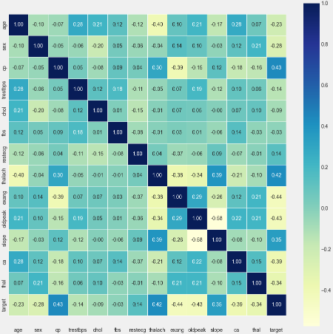
Correlation
Plot
3 Step Process
Split the dataset
Train the dataset
Finding best Algorithm Model
13
13

Slide 14
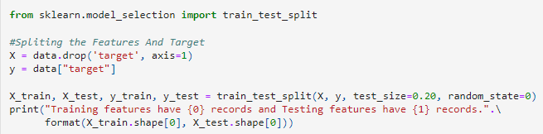
Splitting data
3 Step Process
Correlation
Plot
Split the dataset
Train the dataset
Finding best Algorithm Model

Slide 15
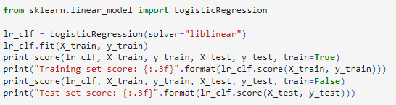
Splitting data
Logistic Regression
Correlation
Plot
Training Features : 242
Testing Features : 61
15

Slide 16
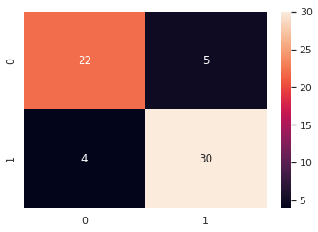
Logistic Regression
Splitting data

Slide 17
Logistic Regression
accuracy score : 85.25 %
Precision (TP/(TP+FP)) : 0.86
Recall is (TP/(TP+FN)) : 0.88
F1-Score is (2 * (precision * recall) / (precision + recall)) : 0.87

Slide 18
Future Scopes
Logistic Regression
Use of AI and Machine Learning: Artificial intelligence and machine learning are already being used in healthcare to help predict heart disease. In the future, these technologies could become more advanced, enabling more accurate predictions of heart disease risk.
Wearable Technology: Wearable devices like smartwatches and fitness trackers can monitor heart rate and other biometric data. As this technology becomes more advanced, it may be possible to use this data to predict heart disease risk.
Genetic Testing: Genetic testing can identify genetic markers that increase the risk of heart disease. As the cost of genetic testing decreases, it may become more widespread, allowing more people to identify their risk of heart disease.
Personalized Medicine: With advances in genetic testing and other technologies, it may be possible to develop personalized treatments for heart disease based on an individual's genetic profile and other risk factors.
Integration of Health Data: With the increasing use of electronic health records, it may be possible to integrate health data from multiple sources to create a more complete picture of a patient's health and predict their risk of heart disease.

Slide 19


